Slide 1
AED Final Project
—City Healthcare System
Name:Jinli Yu
NUID:001617781

Slide 2
Problem Statement
The health condition of citizens is important to a city. It is related closely to the happiness level and the development of a city.
However, it is usually difficult for government to monitor the health condition of citizens frequently and to make decisions correspondingly.

Slide 3
The proposed solution
Develop an IOT application that will enable a city to monitor the health conditions of its population.

Slide 4
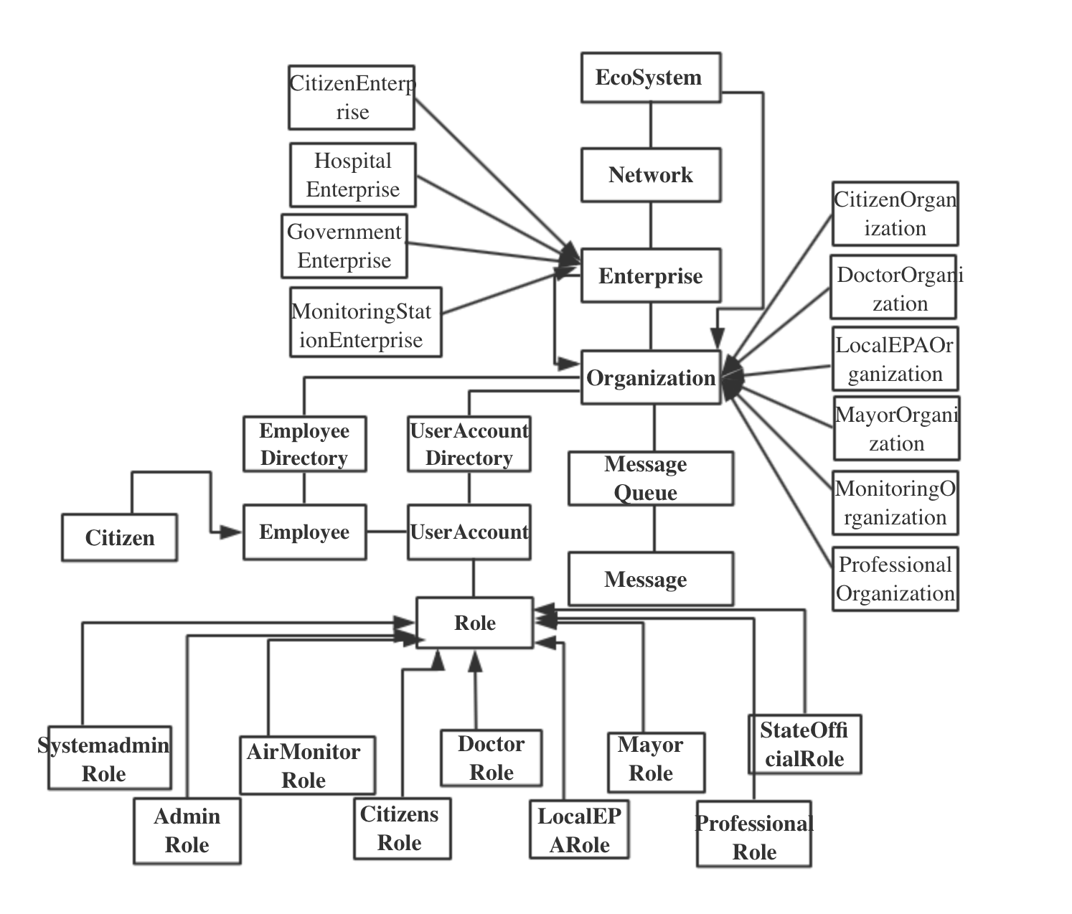

Slide 5
Key Roles
Citizen Role:Input their vital signs and health condition at regular intervals/check result calculated by this system/reset user password
Doctor Role:Create user account and input basic information for citizens/check vital signs citizens input

Slide 6
Key Roles
Air Monitor Role:Acquire real-time data of air condition(AQI)
Local EPA Role:send warning messages to different kind of citizens according to the data of air conditions
Professional Role:view the results of collected vital signs/send health report of whole city to mayor

Slide 7
Key Roles
Mayor Role:Check warning messages send by state health officials/read health report send by professionals
State Health Official Role:view the result of collected vital signs/send warning to mayors

Slide 8
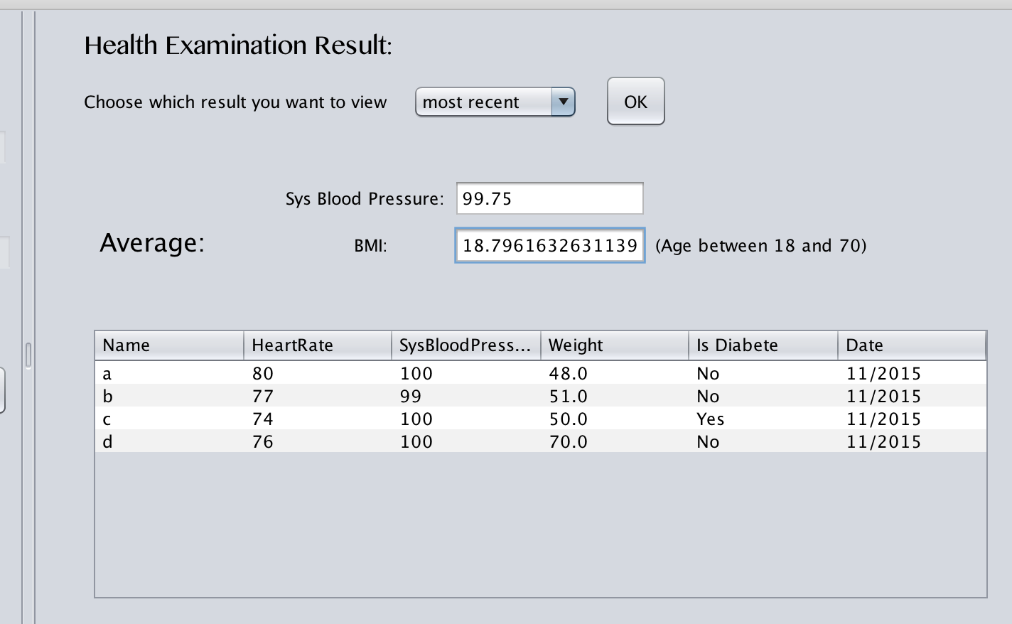
Key Features
Calculate the average value of some vital signs and basic information automatically

Slide 9
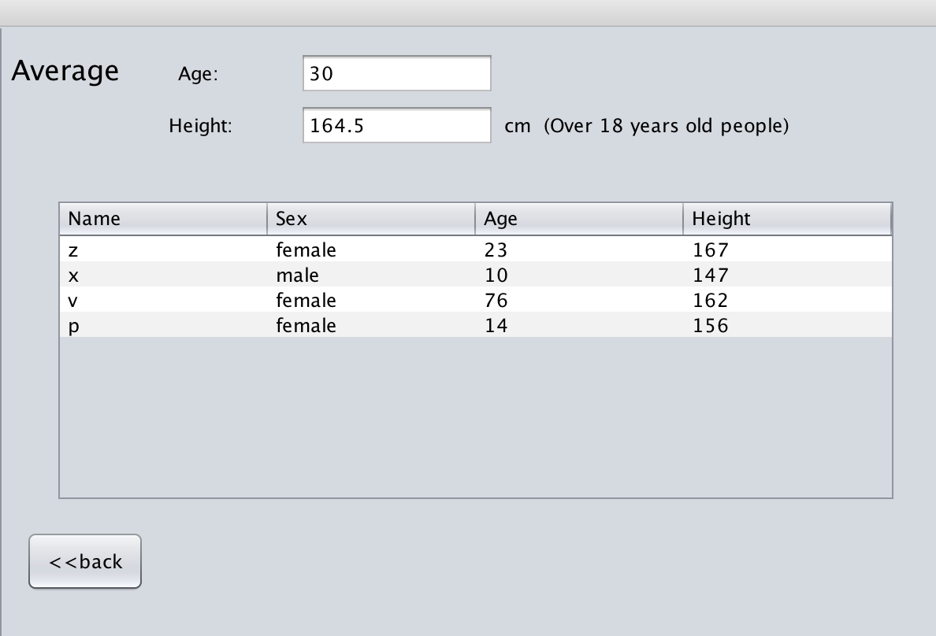
Key Features
Calculate the average value of some vital signs and basic information automatically

Slide 10
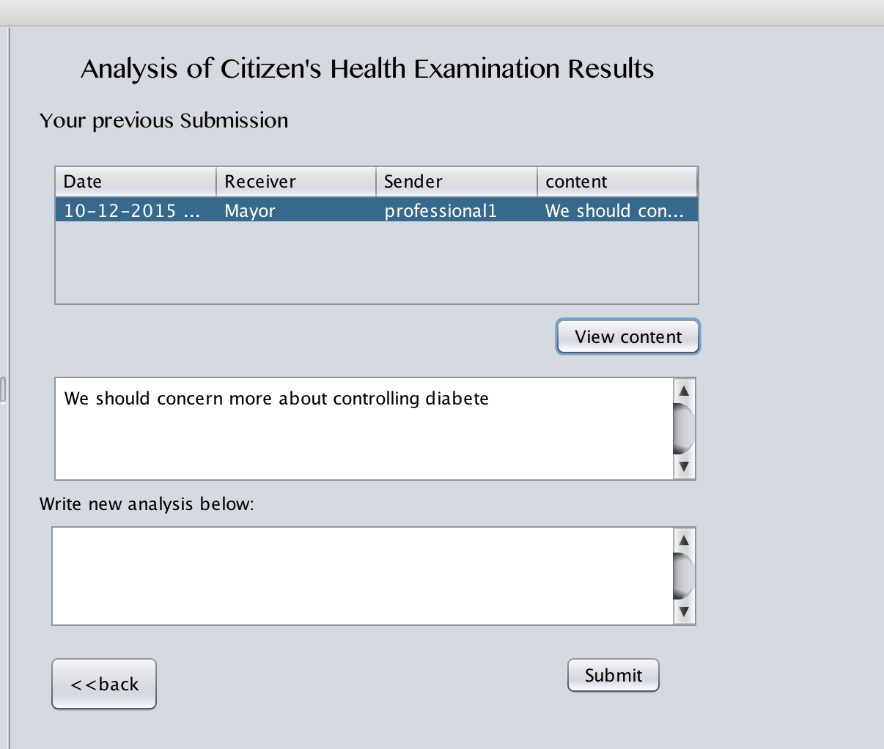
Key Features
There are communications between different roles. Such as Mayor and State Health Official, local EPA and citizens.

Slide 11
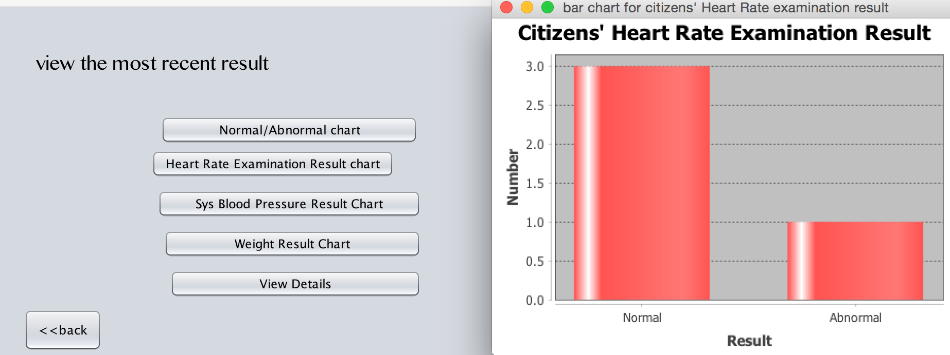
Extra Features
Some of the results could be viewed by bar chart or line chart.

Slide 12
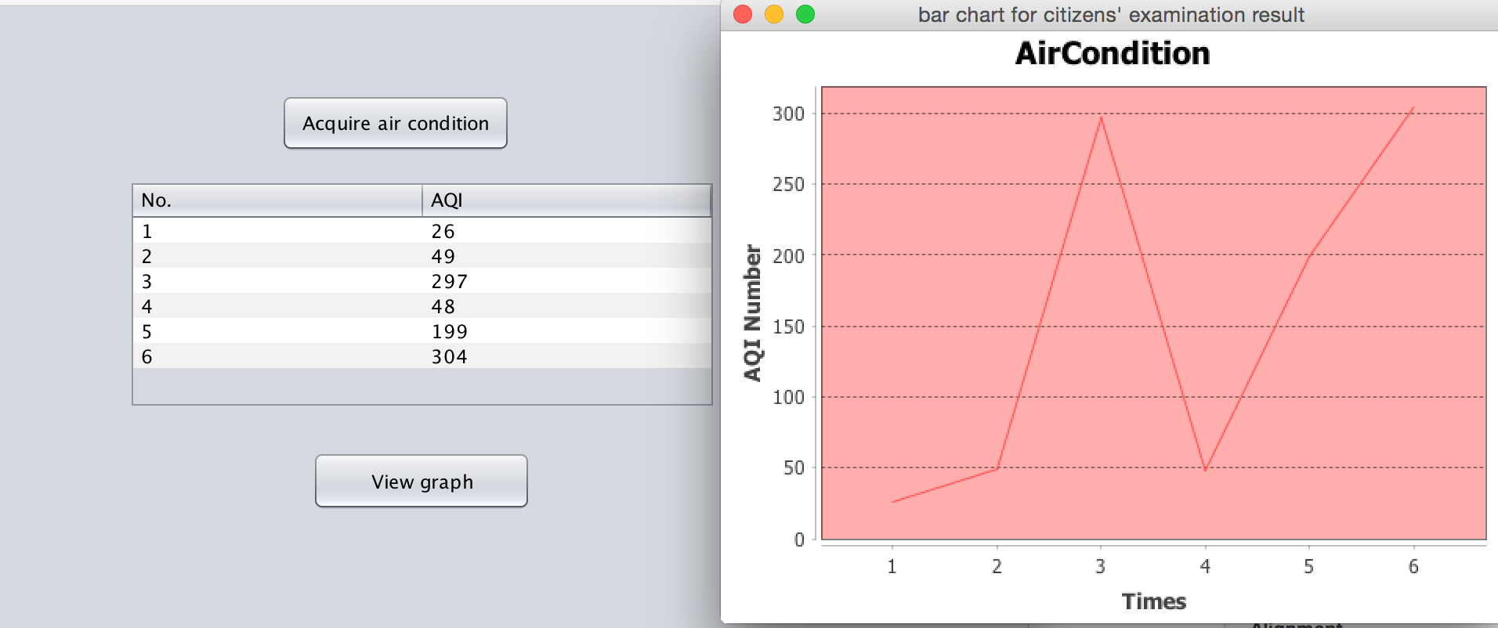
Extra Features
Some of the results could be viewed by bar chart or line chart.

